Slide 1



Forecasting of Electricity Prices
Project:
:Created By:
Debjit Sarkar(1000219059)
Arpan Sadhukhan(10000219022)
Srijan Dutta(10000219075)
Guided by:
Dr. Sayani Mondal
Dept. of Information Technology
MAKAUT, WB

Slide 2

Contents:
Introduction
Literature Study
Motivation
Objective
Methodology
Data Collection
Data Statistics
Results – 1.SVM 2.ARIMA 3.ANN
Conclusion

Slide 3


:Introduction:
1
2
3
4
The future development of the world power industry and the application of power science research are focused on the reform of power marketization. The main content of the reform is to compete in different
levels of power generation, transmission, distribution, and sales. Electricity price reform is the focus of marketization.
Residential electricity consumption in India has increased by a factor more than 50 since 1971. India’s electrified households on average still consume less than one-third of the world’s average for electricity. Rapid electrification, increasing incomes and technology development can result in increased appliance ownership and higher electricity use.
Electricity prices affect the operation of the entire electricity market and are extremely important to every market participant. Each participant trades in the electricity market based on the price of electricity. In the market competition, if the electricity price is accurately predicted in advance, it can be in a favorable position to obtain more benefits..
However, due to the unique characteristics of electricity and the uncertainty of market and bidding strategies, electricity price forecasts become more complex than power load forecasting.

Slide 4
:Literature Study:
Year of Publication | Paper Name | Author Name | Summary
2015 | Midterm Electricity Market Clearing Price Forecasting Using Two-Stage Multiple Support Vector Machine | Xing Yan et. al. | The electricity market clearing price (MCP) is essential for maintenance scheduling, planning, bilateral contracting, resources reallocation, and budgeting. A two-stage multiple support vector machine (SVM) based midterm forecasting model of the electricity MCP is proposed. Compared to the forecasting model using a single SVM, the proposed model showed improved forecasting accuracy in both peak prices and overall system.
2018 | A hybrid electricity price forecasting model with Bayesian optimization for German energy exchange | Cheng et. al. | Hybrid method, with using empirical wavelet transform (EWT), support vector regression (SVR), Bi-directional long short-term memory (BiLSTM) and Bayesian optimization (BO), is proposed to increase the accuracy of electricity price forecasting. Five different case studies are adopted to verify the effectiveness of BO, EWT and hybrid model respectively.
2020 | PSO–LSTM for short term forecast of heterogeneous time series electricity price signals | Venkateswarlu Gundu et. al. | Deep neural network is the best model for learning the non-linear behavior of the data and for the purpose of forecasting. Long term forecasting is not viable as there is an uncertainty in the forecast due to increasing integration of renewable sources with the existing grids. Particle swarm optimization technique is used to optimize the LSTM network input weights, which in turn minimize the forecast error.
2021 | Long-term forecasting model for future electricity consumption in French non-interconnected territories | Mathieu Caron | Thesis focuses on the long-term forecasting of hourly electricity demand. Historical data are first analyzed through a clustering analysis to identify trends and patterns, based on a k-means clustering algorithm. Generalized additive model, a relatively new model in the energy forecasting field, gives promising results.
 | Q1 | Q2 | Q3 | Q4
Series 1 | 4.3 | 2.5 | 3.5 | 4.5
Series 2 | 2.4 | 4.4 | 1.8 | 2.8
Series 3 | 2 | 2 | 3 | 5
Series 4 | 3.4 | 6 | 2.3 | 1

Slide 5
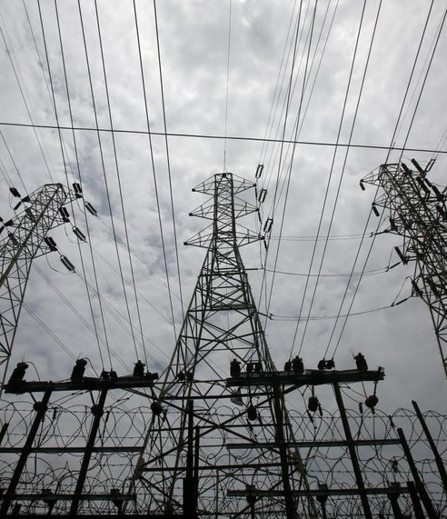
Motivation:
Growth in population and increased urbanization always cause upward pressures to energy demand.
India is the second most populous country in the world with a yearly population growth of 1.5% and one third of the population. It seriously contributes to the rise in global energy demand.
There is a high urbanization trend in India. According to the International Energy Agency 315 million people, equal to the population of USA, will have moved to Indian cities by 2040
1971: Electricity consumption by households in India- 4 billion kWh. 4% of the total electricity consumption in the country.
2015-16: Electricity consumption by households in India- 238 billion kWh, 24% of the total electricity consumption in the country.

Slide 6

Objectives:
Forecasting can be categorized into three classifications:
Short term forecasting (typically ranges from 1 h to 1 week),
Medium-term forecasting (varying from 1 week to 1 year),
Long term forecasting (exceeding 1 year)
Forecasting Market Clearing Price using Day Ahead Prices in the deregulated electricity market.
Medium-term and Long-term forecasting for West Bengal, Sikkim, Bihar, Jharkhand, and Odisha.

Slide 7

Methodology:
Approach: 1
(Mid-term electricity market clearing price forecasting using Multiple support Vector Machine)
Approach: 2
Long-term electricity market clearing price forecasting using ANN and ARIMA model (to be done later on).
Dataset Collection
Collected from Indian Energy Exchange
Applying Support Vector Machine(SVM)
(The goal of the SVM algorithm is to create the best line or decision boundary that can segregate n-dimensional space into classes so that we can easily put the new data point in the correct category in the future)
Data Validation
Data Pre-processing (Data Cleaning + Normalization)
In this phase we will fix or remove incorrect, corrupted, incorrectly formatted, duplicate & missing data in the given dataset
**Accuracy prediction**

Slide 8
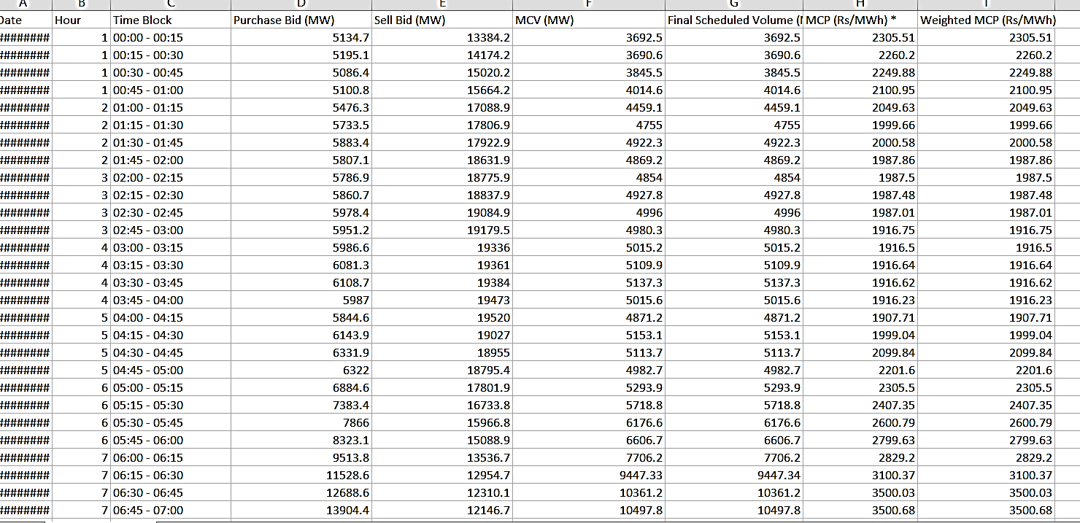
Data Collection:
Data Collected from: IEX (https://www.iexindia.com/marketdata/areaprice.aspx)
Features Considered:
Purchase Bid (PB)
Market Clearing Volume (MCV)
Sell Bid(SB)
Market Clearing Price (MCP)
Dataset Collected: 15- minute Data
Mid-term: 01 January 2021 to 31st March 2021
Long-term: 01 January 2015 to 31st December 2021
:Sample Data:

Slide 9

Data Statistics:
Purchase & sell bid
Initially we are considering the data of the months- January, February and March of the year 2021 as our training data.
The whole data is divided into 9 columns named as:
1) Date 2) Hour
3) Time Block 4) Purchase Bid(MW)
5) Sell Bid(MW) 6) MCV(MW)
7) Final Schedule Vol(MW) 8) MCP(Rs/MWh)
9) Weighted MCP(Rs/MWh)
Among them we are considering 7 Columns: Date, Hour, Time Block, Purchase Bid, Sell Bid, MCV, MCP
Considered
Features:
Price at which a seller is willing to sell is known as purchase bid.
Price at which buyer is willing to pay is known as sell bid
MCV
MCP
Market Clearing Volume
The market is cleared at an equilibrium point where both generation and demand bids meet.
Market Clearing Price
The price at which the quantity supplies equals to quantity demanded.
In January, total number of rows are: 2976
In February, total number of rows are: 2688
In March, total number of rows are: 2976

Slide 10
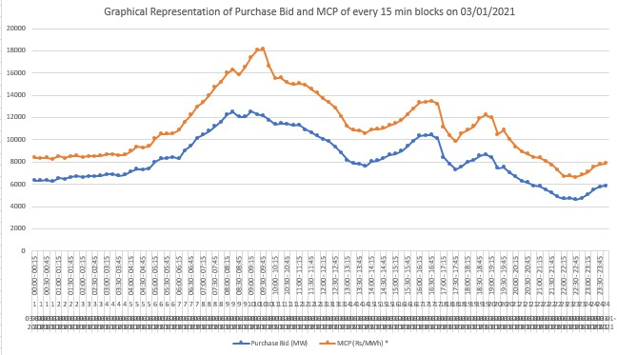
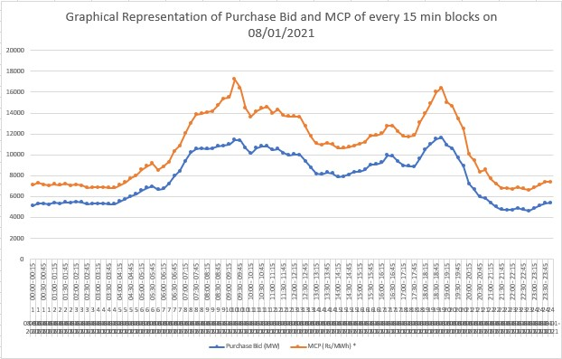
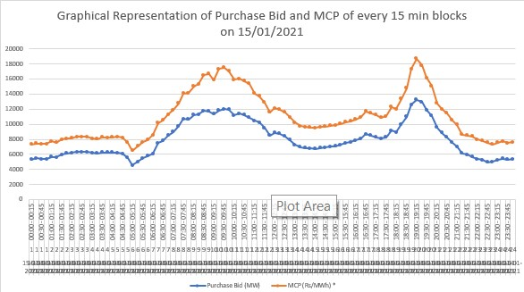
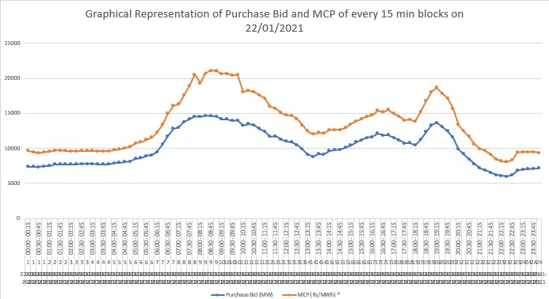
Data Visualization(1)
We have taken 4 dates 03-01-2021, 08-01-2021, 15-01-2021, 22-01-2021 arbitrarily.
Then we have plotted Purchase Bid and MCP of every 15 minute blocks of each four dates to visualize the trend.

Slide 11
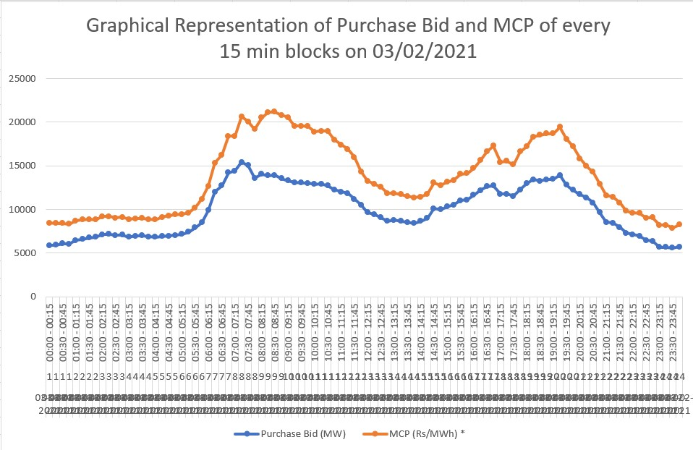
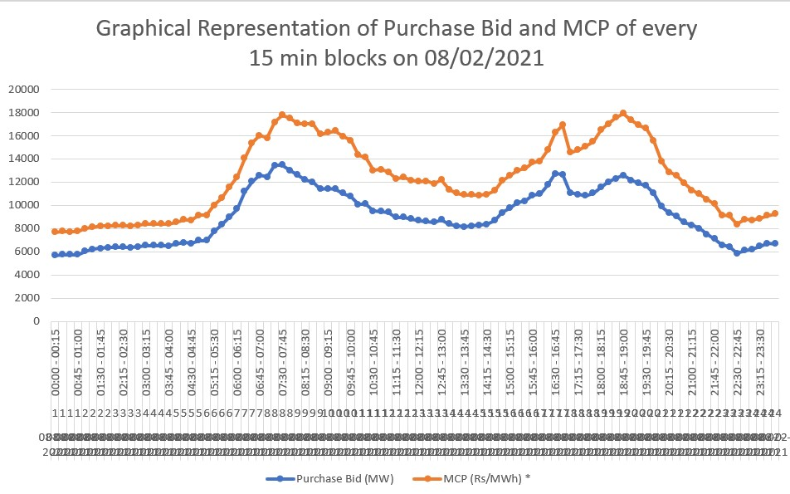
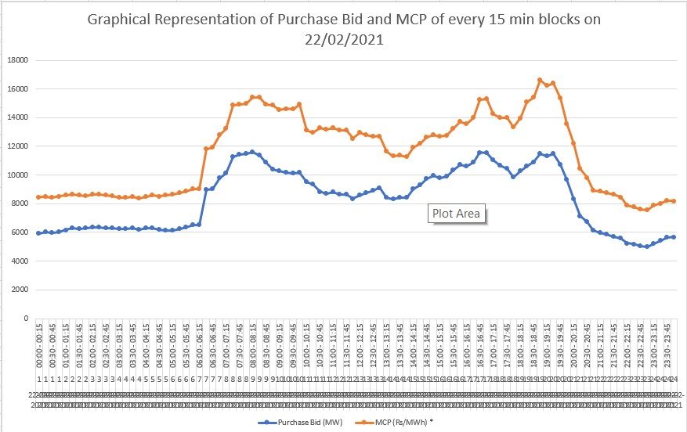
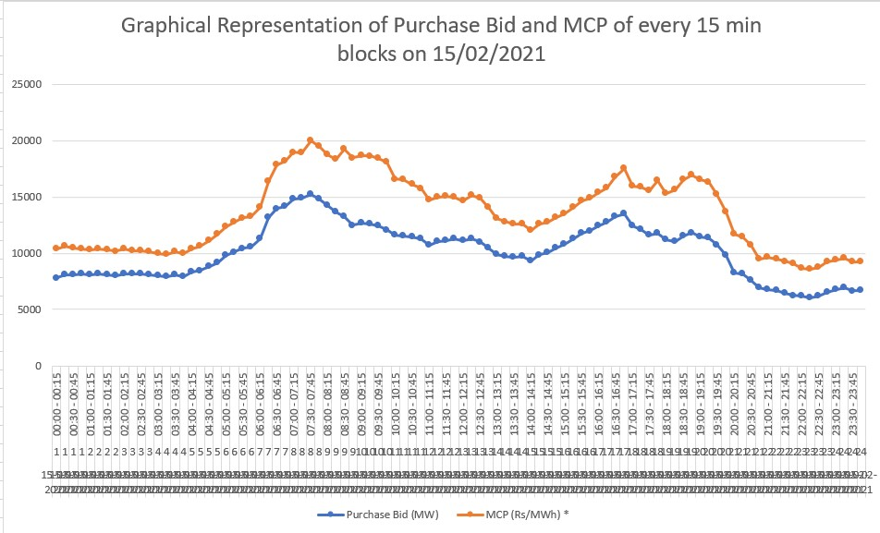
Data Visualization(2)
We have taken 4 dates 03-02-2021, 08-02-2021, 15-02-2021, 22-02-2021 arbitrarily.
Then we have plotted Purchase Bid and MCP of every 15 minute blocks of each four dates to visualize the trend.

Slide 12
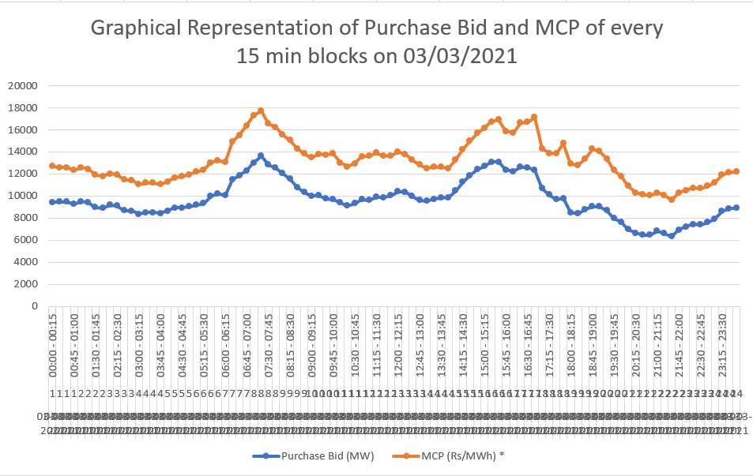
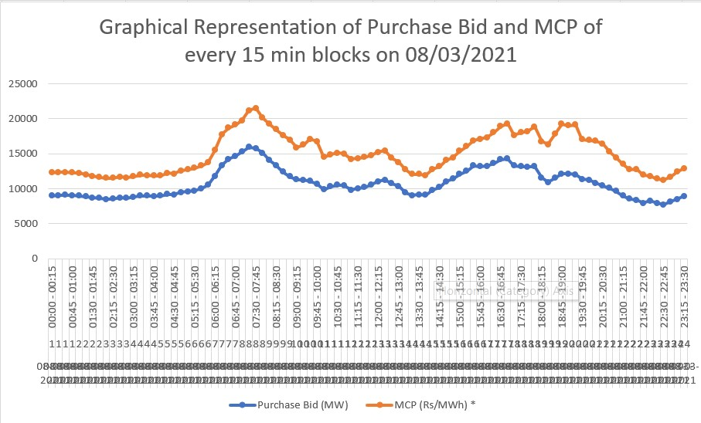
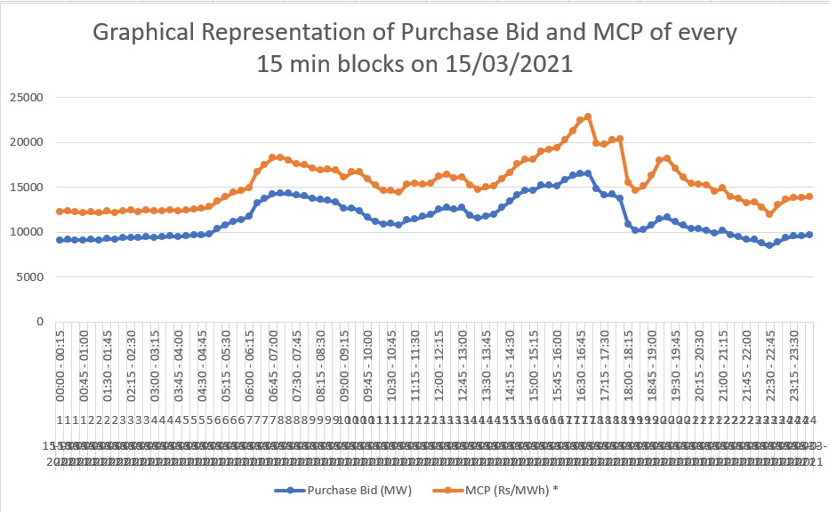
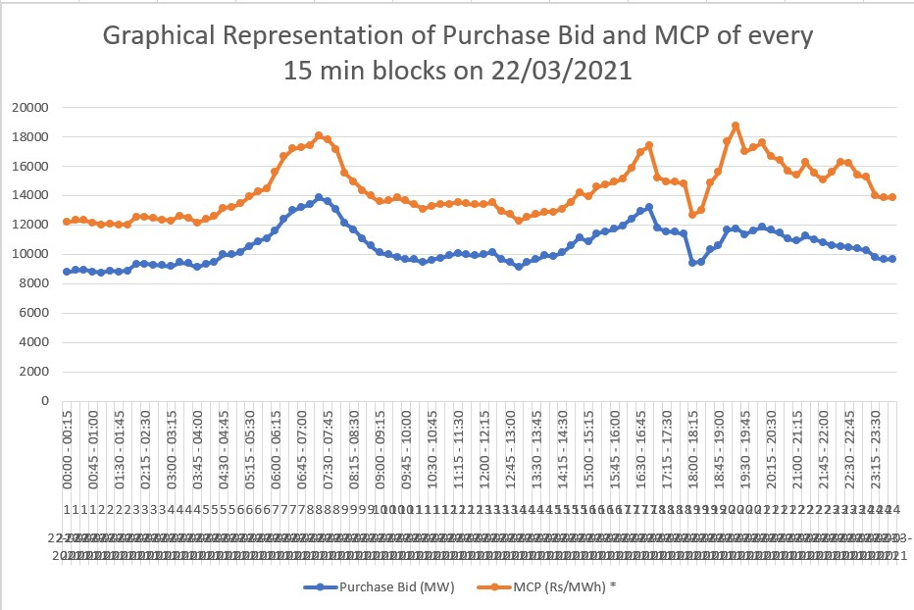
Data Visualization(3)
We have taken 4 dates 03-03-2021, 08-03-2021, 15-03-2021, 22-03-2021 arbitrarily.
Then we have plotted Purchase Bid and MCP of every 15 minute blocks of each four dates to visualize the trend.

Slide 13
RESULTS

Slide 14
1.Support Vector Machine (SVM)
What is Support Vector Machine
Why we used Support Vector machine
Support Vector Machine or SVM is one of the most popular Supervised Learning algorithms, which is used for Classification as well as Prediction problems.
The goal of the SVM algorithm is to create the best line or decision boundary that can segregate n-dimensional space into classes so that we can easily put the new data point in the correct category in the future. This best decision boundary is called a hyperplane.
Support Vector Regression which comes under SVM algorithm is popularly used in forecasting because of its various kernel functionality.
As we can change the kernel function , we can have multiple hyperplane and easily choose the best one.

Slide 15
SVM:
Data Collection and Pre processing
Scaling and Feature selection
As mentioned earlier data has collected from IEX.
Collected data has been pre-processed using ML preprocessing functions.
Remove some rows containing missing values.
Standardize the preprocessed data using standard deviation.
In feature Selection we have followed the co-relation generated using heatmap() function.

Slide 16
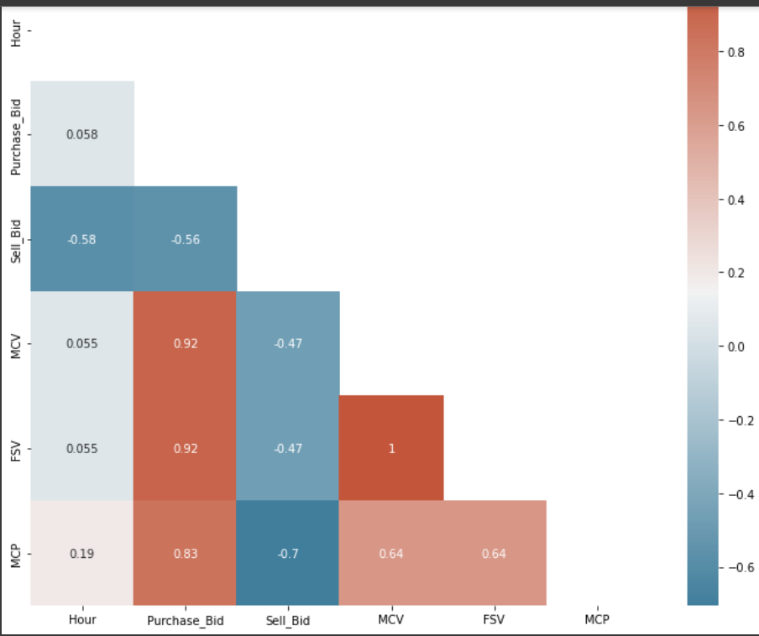
SVM: Heatmap output:
Heatmap Shows the co-relations between the features .

Slide 17
SVM:
Selected features
Data Splitting
Hour
Purchase Bid
Sell Bid
MCV
FSV
For training purpose we took 80% of our data.
Remaining data used for testing purpose (i.e remaining 20%).
Applying and Fitting Model
Dropped features
After all the Steps of preprocessing and splitting , applied our SVM Model (Support Vector Machine )
Used Linear Kernel .
Then Fit the model with training data
Time Block

Slide 18
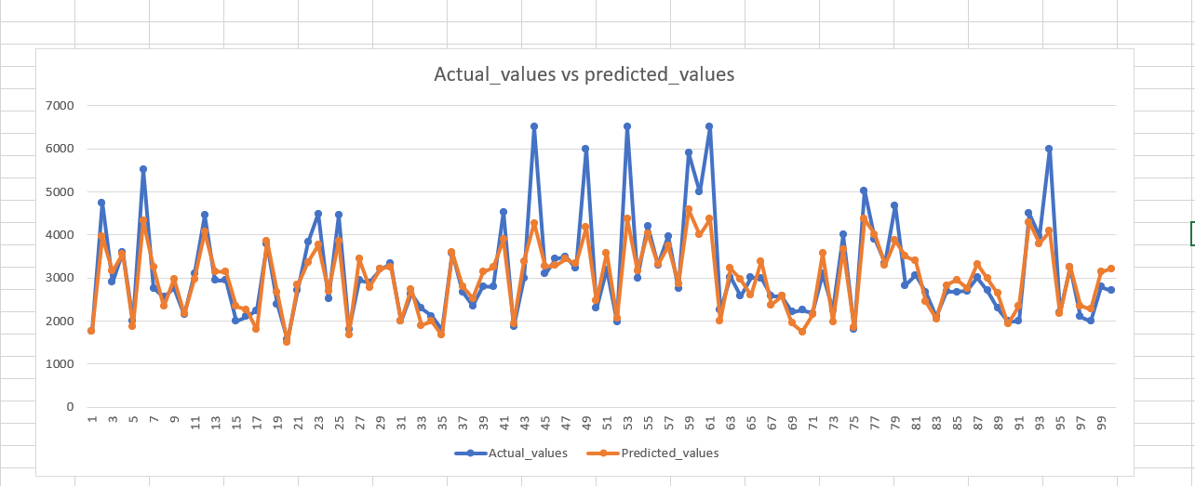
SVM: Accuracy of the Model
After applying and fitting the SVM Model We get 72% Accuracy.
Actual value vs Predicted value

Slide 19
2.Arima:
An autoregressive integrated moving average, or ARIMA, is a statistical analysis model that uses time series data to either better understand the data set or to predict future trends.
A statistical model is autoregressive if it predicts future values based on past values. For example, an ARIMA model might seek to predict a stock's future prices based on its past performance or forecast a company's earnings based on past periods.

Slide 20
ARIMA: Dataset Modification
Arima is a time series forecasting model. So we have modified the dataset according to our needs.
We have changed the index from Serial No. to date time index.
We have merged each date with it’s corresponding time.
We have data from 01-01-2021 00:15 to 31-03-2021 23:45. Total no. of rows 8640.
Among four features we have consider MCP for this. Because Arima is a univariate model.

Slide 21
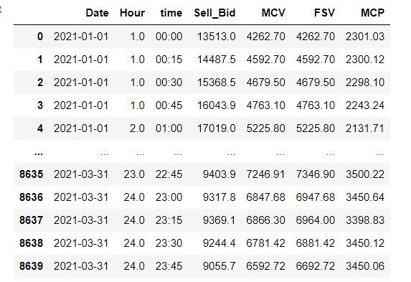
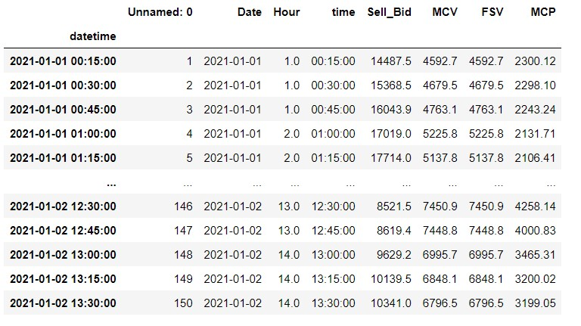
Original Dataset
Dataset after modification

Slide 22
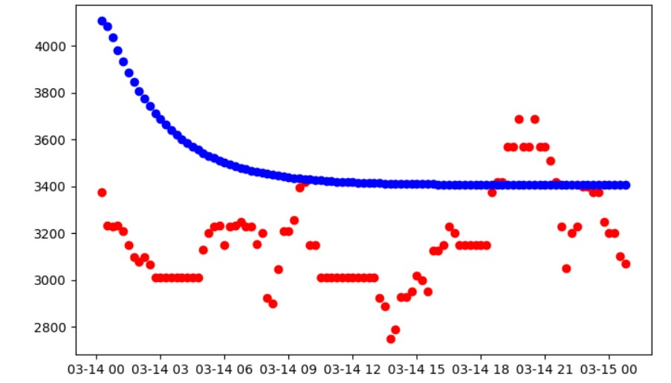
ARIMA: Results
Check for stationarity:
We have applied Augmented-Dickey Fuller test on the dataset to check for it’s stationarity
Data Splitting:
For training purpose we have taken 80% of our data.
For testing we have taken rest 20% data.
Accuracy:
We have MAPE( Mean Absolute Percentage Error) of 0.1841
RMSE of 1440.77
Graph:

Slide 23
3.ANN
Introduction
Advantages
The neural network approach is used to predict the market behaviors based on the historical prices, quantities and other information to forecast the future prices and quantities. The basic idea is to use history and other estimated factors in the future to “fit” and “extrapolate” the prices and quantities to prepare the dataset for ANN prediction, the data frame was divided into three sets, namely training, validation, and testing, in the proportion of 70, 30, and 10, respectively.
Although the linear time series models such as ARIMA are able to take care of the non-stationary and multiple seasonality of the time series, they are unable to capture the volatility of the electric price.
The electricity price apart from exhibiting strong seasonality at the annual weekly and daily levels, mean reversion , very high volatility also shows short lived and unanticipated price changes known as spikes. Price spikes are the main motive for designing insurance and hedging against price movements.
After identifying the spikes they are replaced by the normal, less spiky data/values.
(For electricity the volatility is 50%)
ANN is a black-box model to deal with any non linear time series system with ease with any parameters. ANN’s are adaptive and data driven. So there is no need to make any prior assumptions about the statistical information about the data.

Slide 24
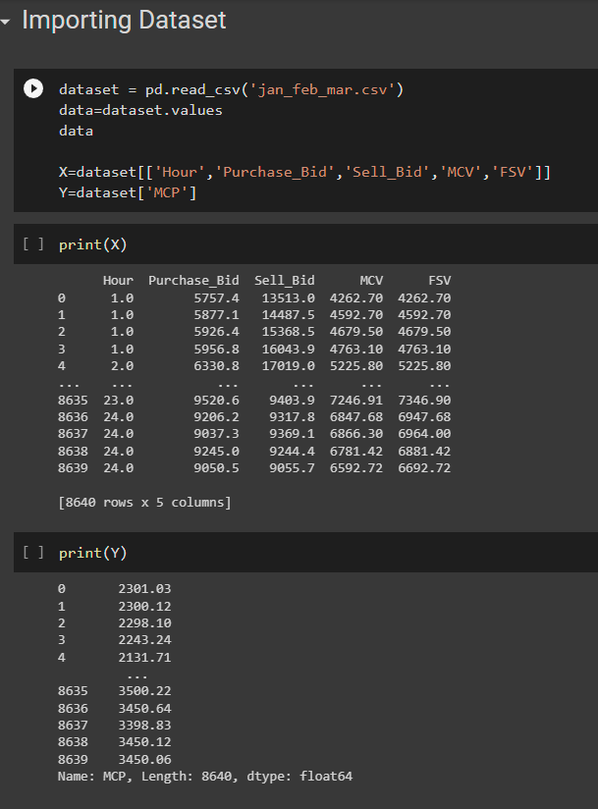
ANN: Workflow
Data Preparation: Collect and preprocess the data. This involves selecting the relevant features, normalizing the data, and splitting the data into training, validation, and test sets.
Model Selection: Select an appropriate ANN architecture, including the number of layers, number of neurons in each layer, activation functions, and optimization algorithms.
Model Training: Train the ANN using the training set. During training, the weights of the ANN are updated iteratively to minimize the error between the predicted and actual prices.
Model Validation: Validate the trained model using the validation set to prevent overfitting.
Model Testing: Test the performance of the trained model using the test set. This involves evaluating the accuracy of the model predictions against the actual prices.
Model Deployment: Deploy the trained model to make price forecasts in real-time.
Dataset for ann: All features considered

Slide 25
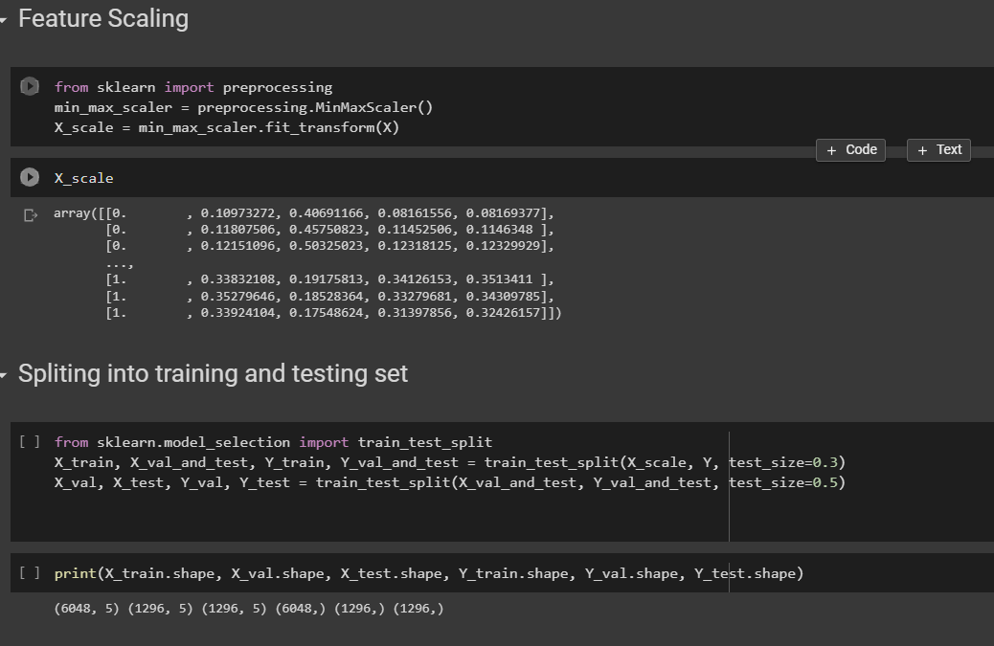
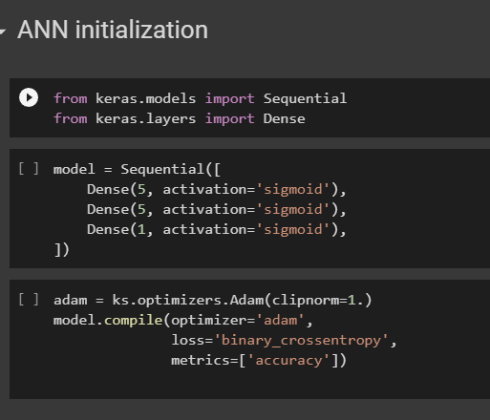
ANN: Data Preprocessing and Model selection
ANN Model Considered
The ann model is created using the Keras API. The model has three layers, each consisting of densely connected neurons.
The first two layers have five neurons each and use the sigmoid activation function. The last layer has a single neuron and uses the sigmoid activation function. The choice of sigmoid activation function indicates that this model is designed for a binary classification problem. If the problem were a multi-class classification or regression problem, a different activation function would be used.
The optimizer used in this model is Adam, which is a popular stochastic gradient descent optimizer. The clip-norm parameter is set to 1, which limits the norm of the gradient to prevent it from becoming too large during training.
The model is compiled using the binary cross-entropy loss function and accuracy as the evaluation metric. Binary cross-entropy loss is a commonly used loss function for binary classification problems. The accuracy metric measures the proportion of correct predictions out of all predictions made.
After compiling the model, it is ready to be trained on the training data and evaluated on the test data.
Feature Scaling

Slide 26
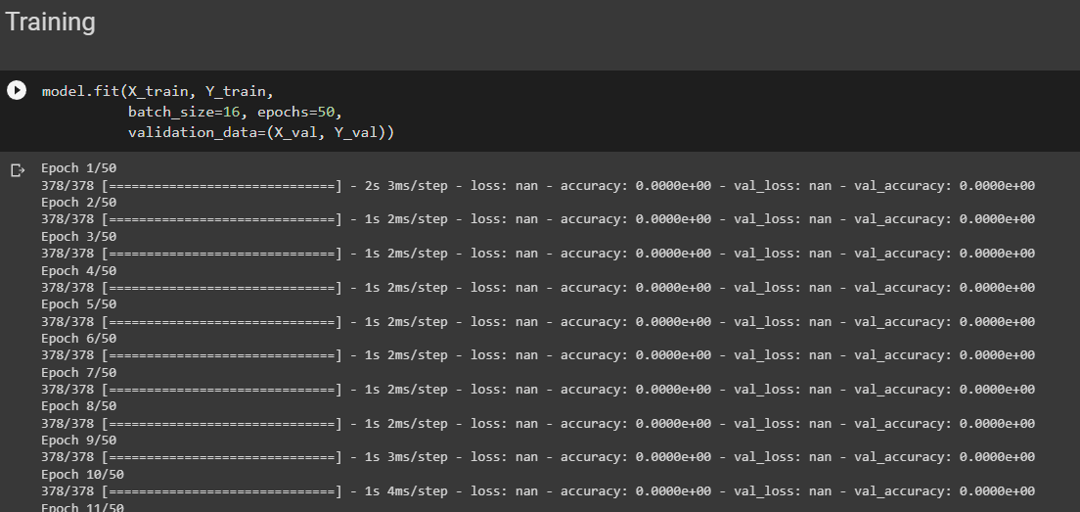
ANN: Limitations and Errors
As we can see in the code snippet a error is coming regarding the accuracy.
We have checked several times the reason of the error and debugged it many times to find the mistake but we are unable to fix that. Hereby, we conclude that ANN may not be the right model for the electricity price prediction or our dataset is not as per as needed for the model.
So we have selected LSTM model as a replacement of ANN and working on it to get it prepared.

Slide 27
LSTM: Introduction
Long Short-Term Memory (LSTM) is a type of Recurrent Neural Network (RNN) that is commonly used for time series forecasting tasks, such as electricity price forecasting. The main advantage of LSTMs over traditional ANNs in this context is their ability to model and capture temporal dependencies and patterns in the data.
Electricity prices are highly volatile and subject to fluctuations based on factors such as weather patterns, demand, and supply. The prices also exhibit time-dependent patterns such as seasonality, trends, and periodicity. LSTMs are well-suited to capture these temporal dynamics and learn the patterns that influence the prices.
LSTMs achieve this by maintaining an internal memory state that can selectively store and forget previous inputs. This allows the network to remember important past information while filtering out irrelevant or redundant information. By doing so, the LSTMs can model the long-term dependencies and the short-term fluctuations in the data more effectively than traditional ANNs.
In contrast, traditional ANNs treat each input independently, without considering the sequential dependencies between them. They are not designed to handle sequential data and can struggle to model temporal dynamics and long-term dependencies in the data.
Therefore, LSTMs have an advantage over traditional ANNs in electricity price forecasting because they can better capture the temporal patterns and dependencies in the data. This can result in more accurate and reliable price forecasts.

Slide 28
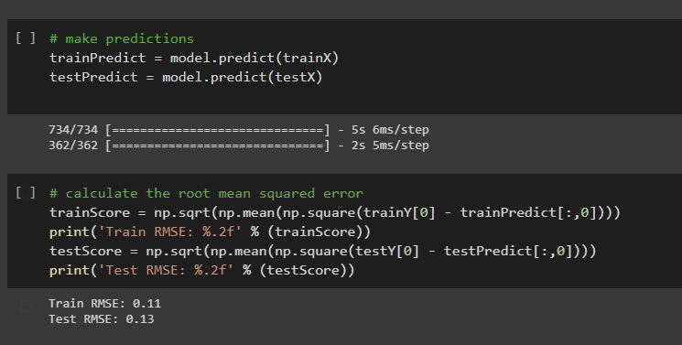
LSTM: Workflow in brief
The code we developed trains an LSTM model on a time-series dataset with 5 features and a look-back period of 12.
The dataset is loaded using numpy, and NaN values are removed. The data is then split into training and testing sets, and the training data is further split into input sequences and target values. The data is then scaled using MinMaxScaler.
The LSTM model is built using Keras, with 100 neurons and a dense output layer. The model is compiled using the Adam optimizer and the mean squared error loss function.
The model is trained using the training data for 10 epochs with a batch size of 32, and the validation data is used to evaluate the performance of the model. The model is then used to make predictions on the training and testing data, and the root mean squared error is calculated to evaluate the performance of the model. Finally, the RMSE of the training and testing data is printed to the console.
RMSE Value

Slide 29

Conclusion:
Improvements:
Various optimization and improvements are planning to be done later on.

Slide 30

THANK YOU

